Slide 1
UI Design 全ページ15
Demo Link

Slide 2
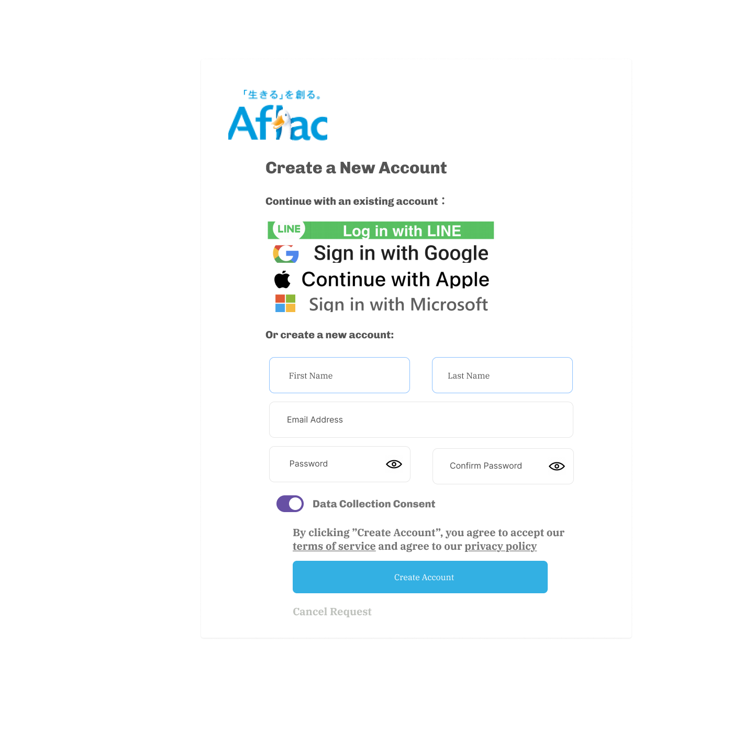
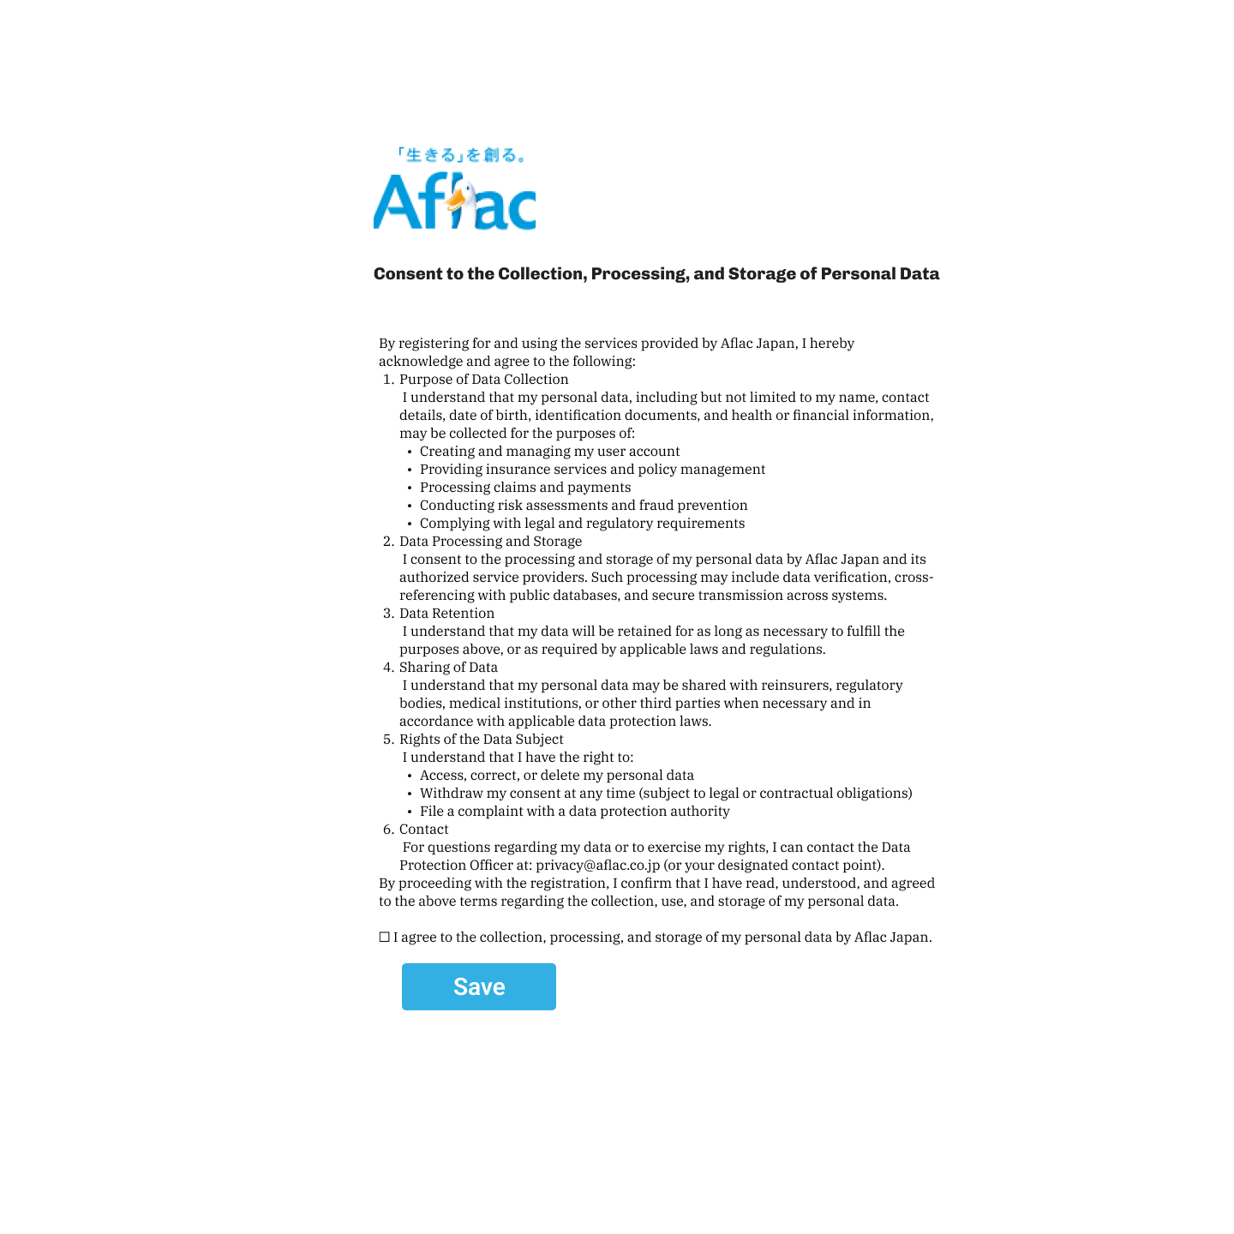
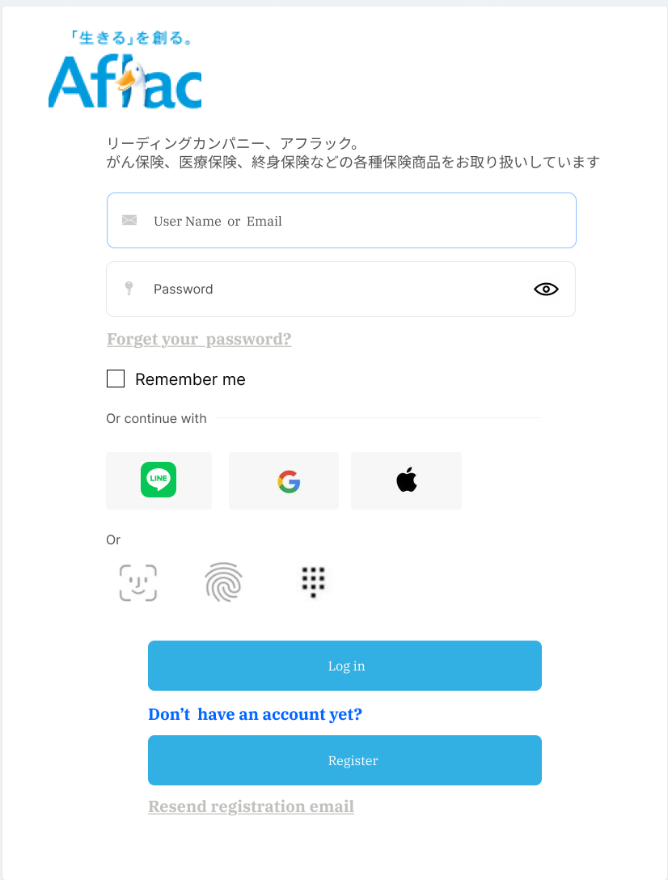
New Account Creation

Slide 3
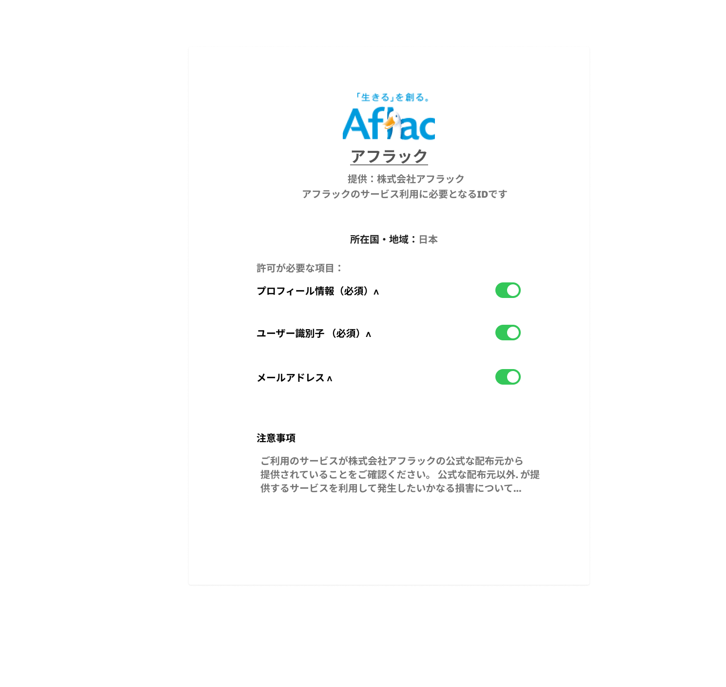
New Account Creation – social login

Slide 4
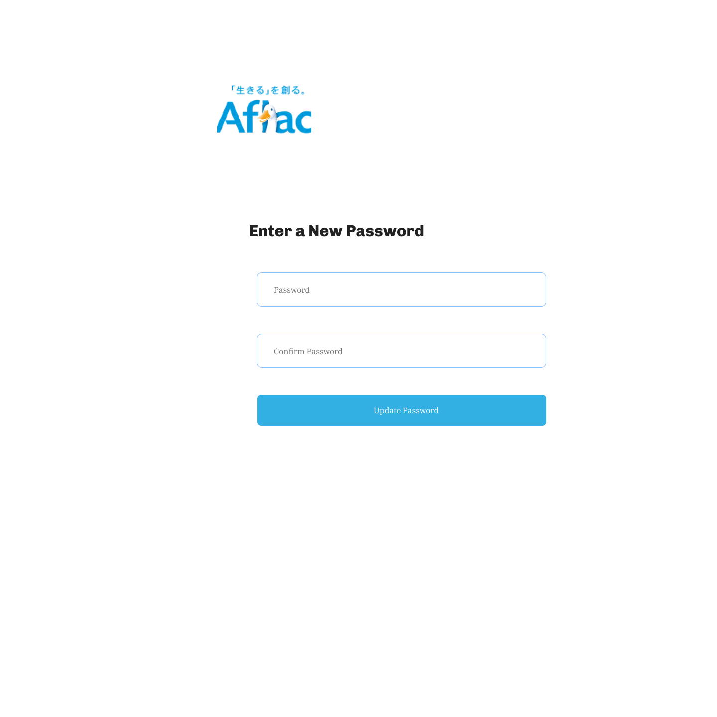
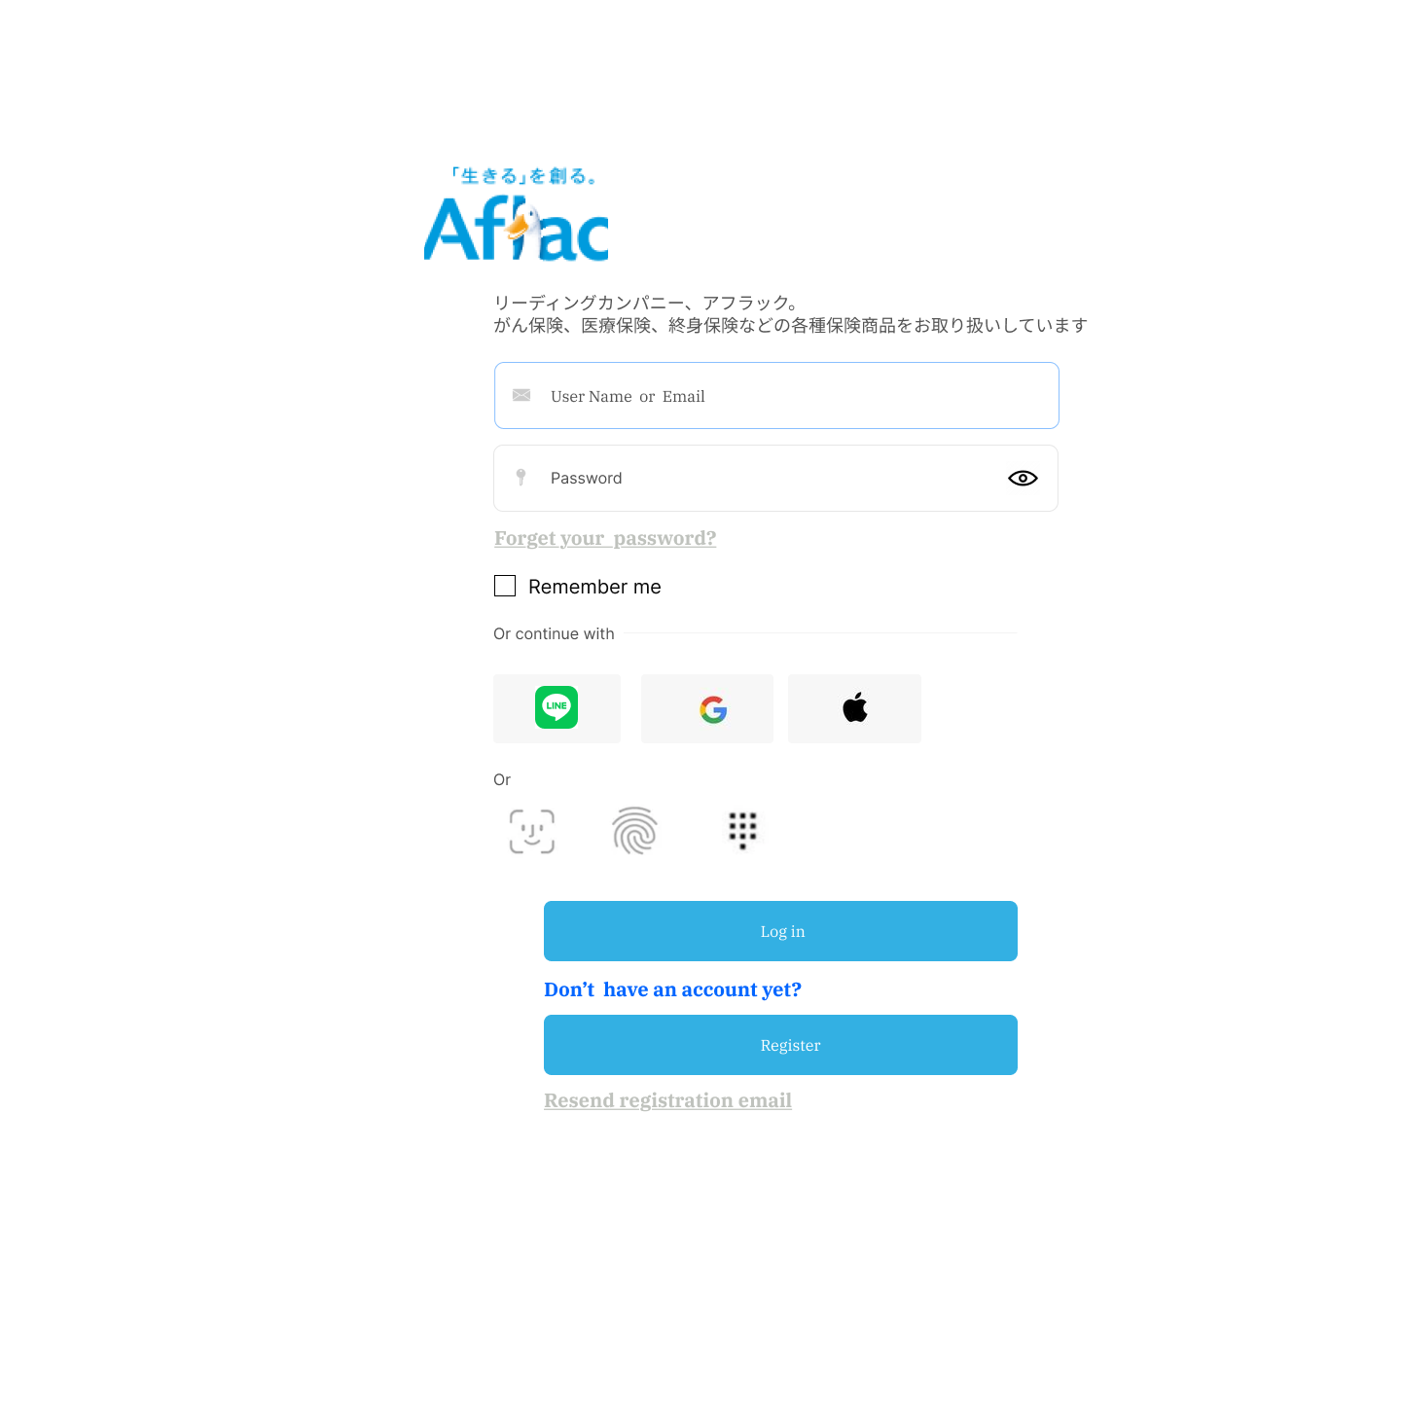
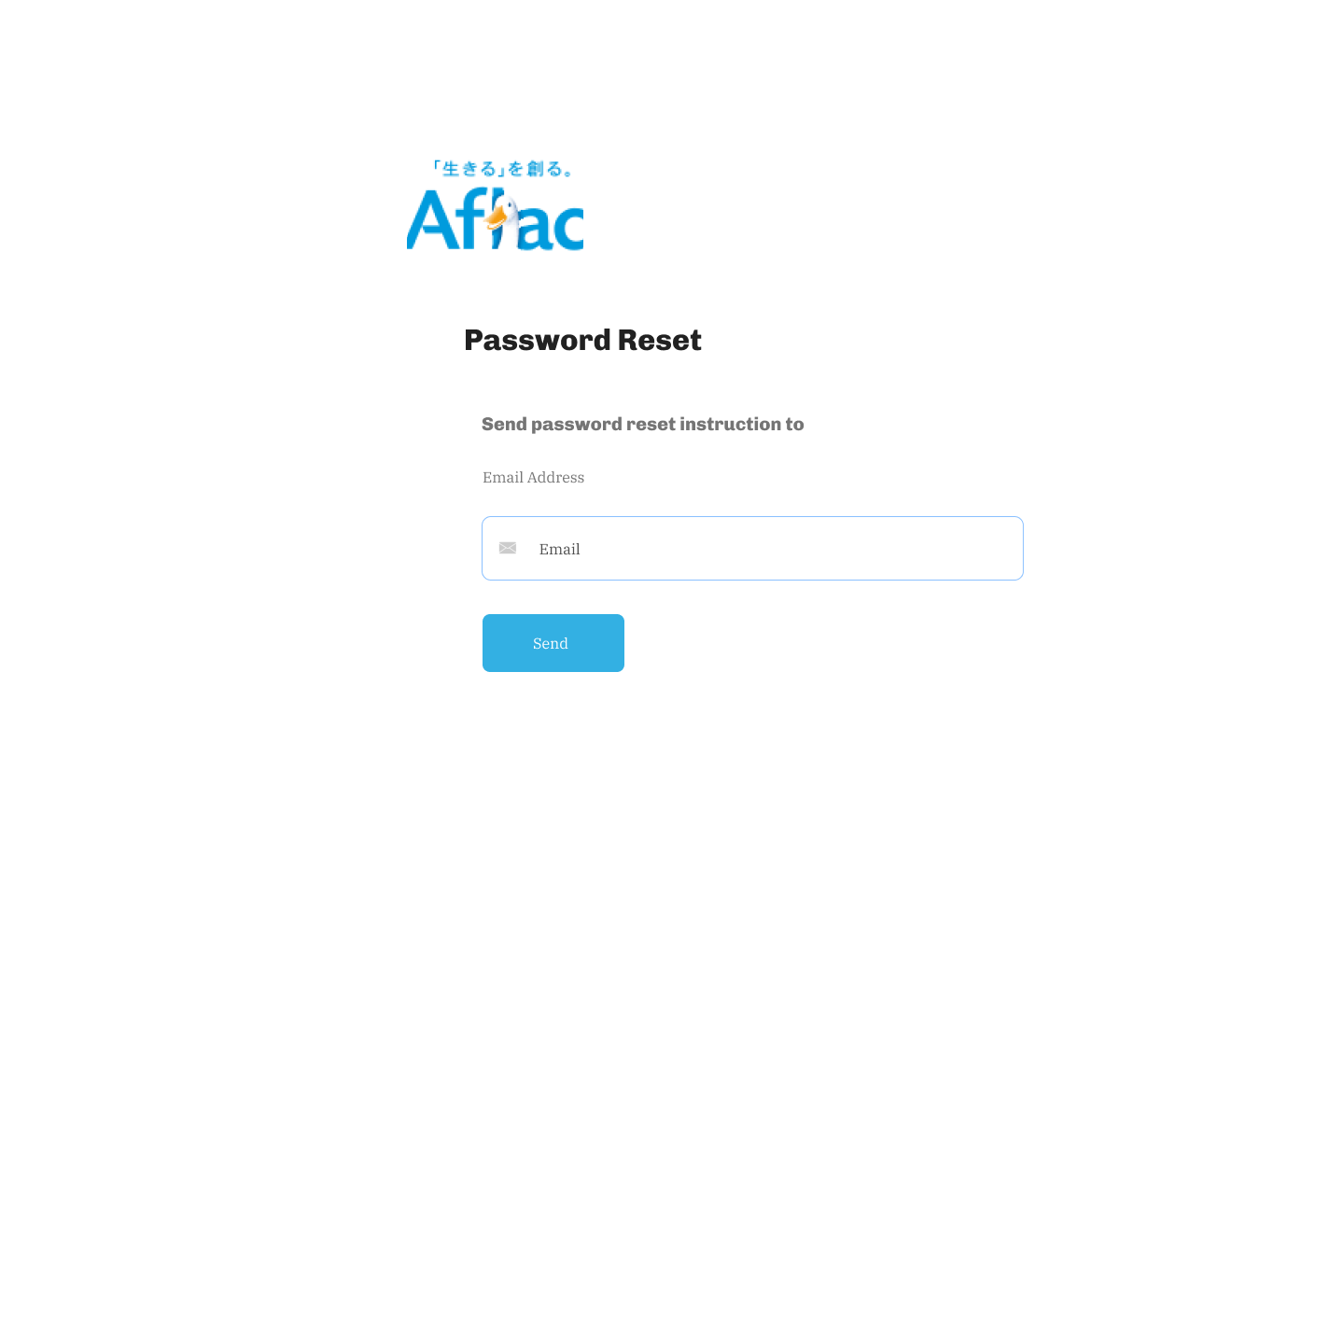
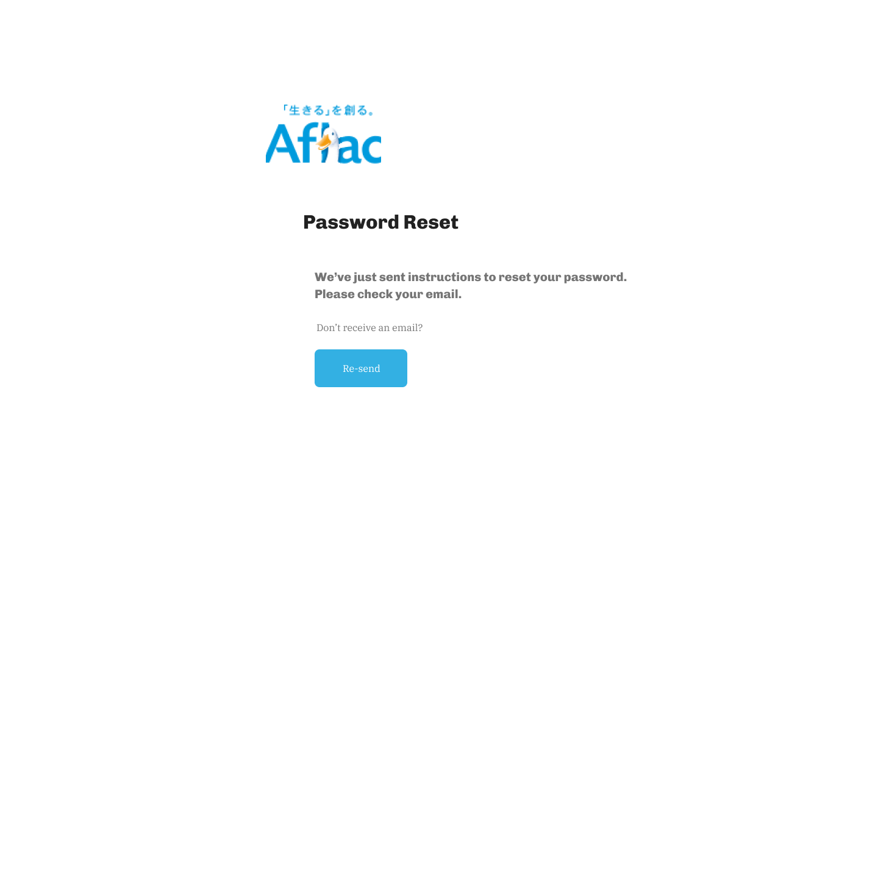
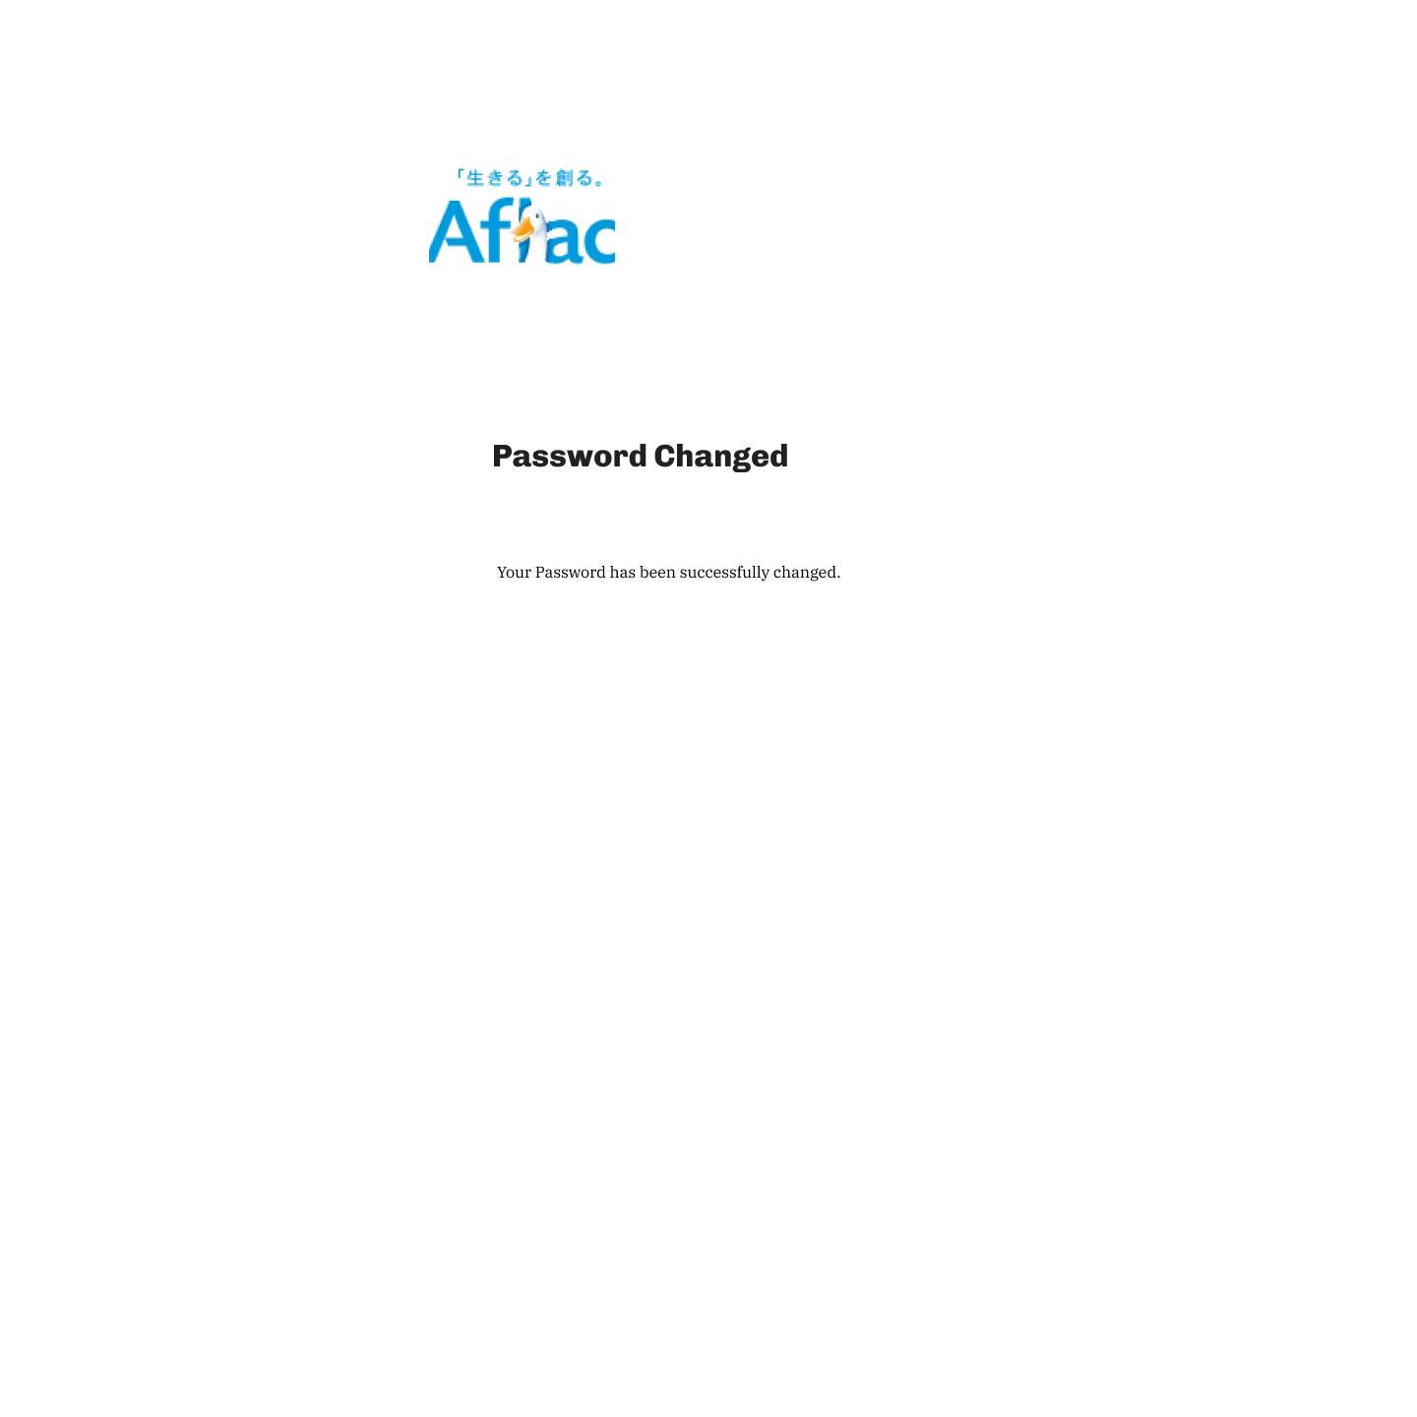
Password Resetting

Slide 5
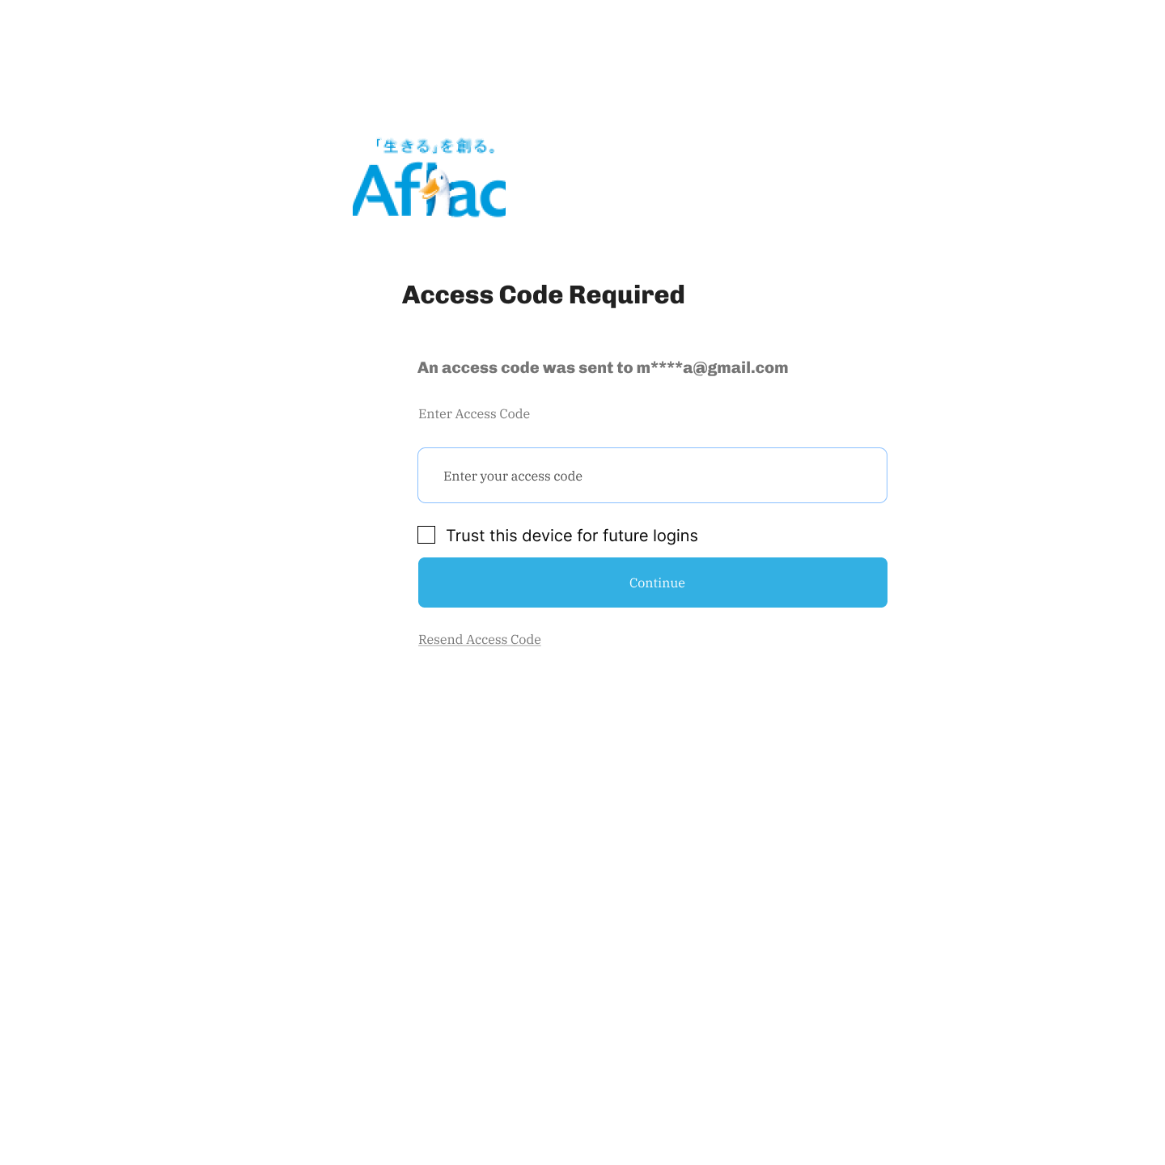
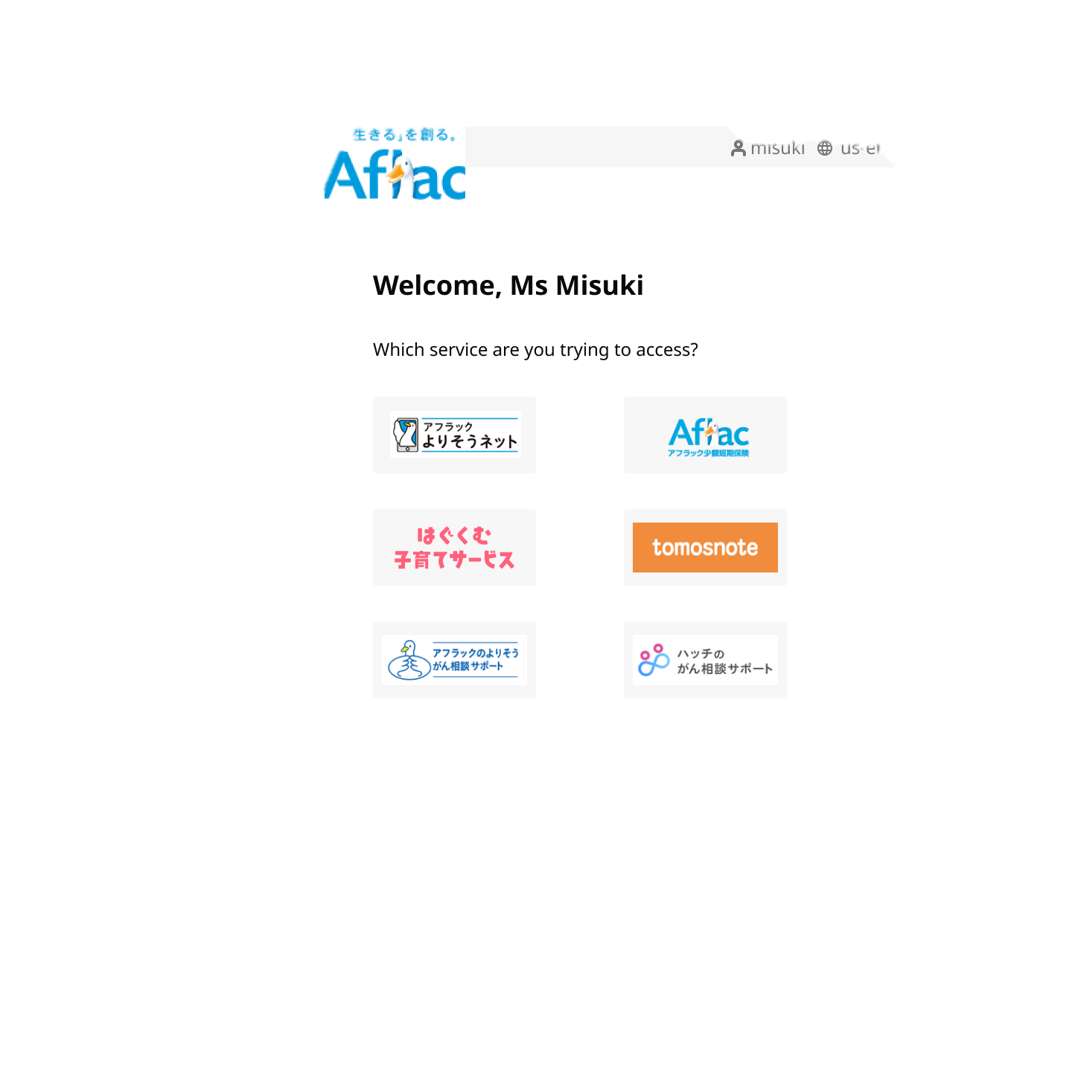
2FA

Slide 6
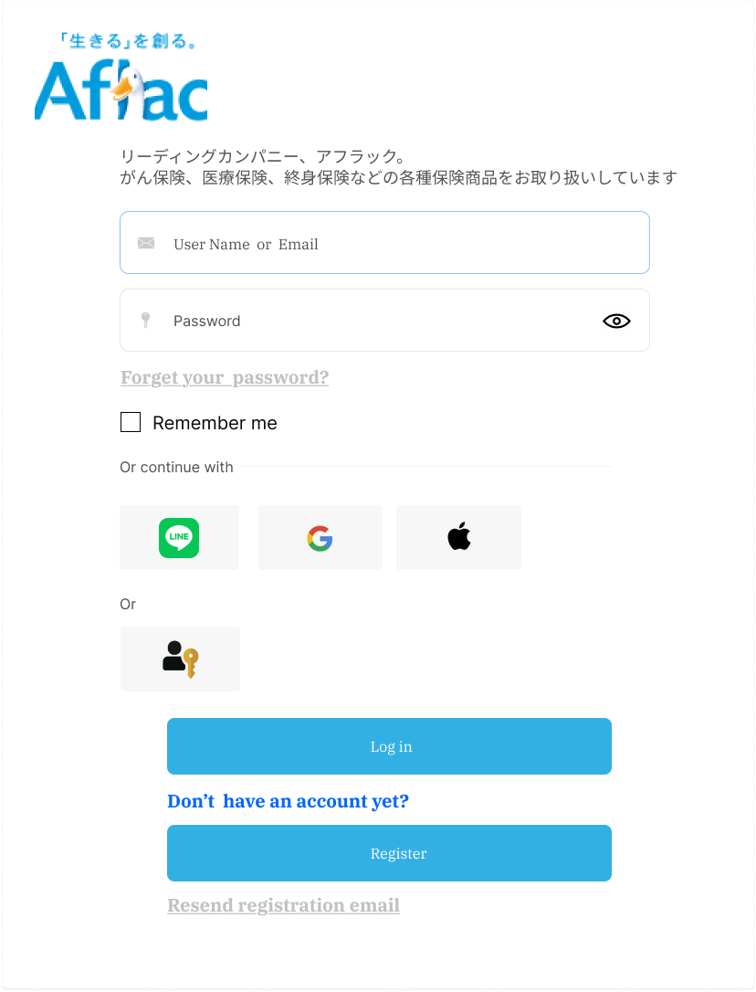
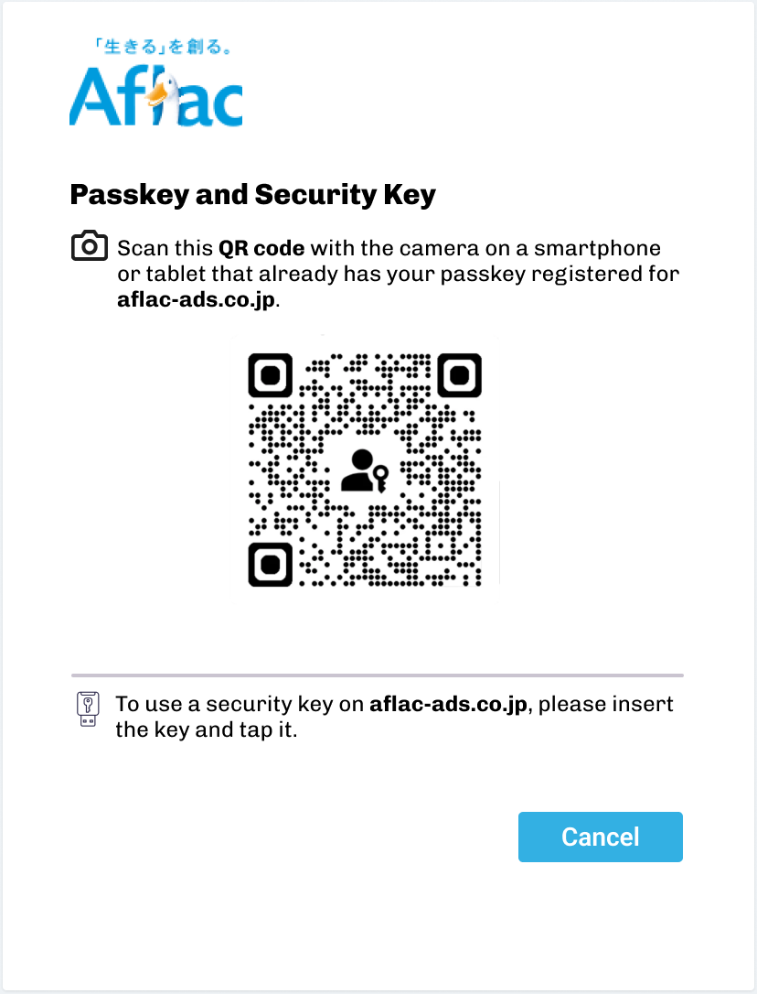
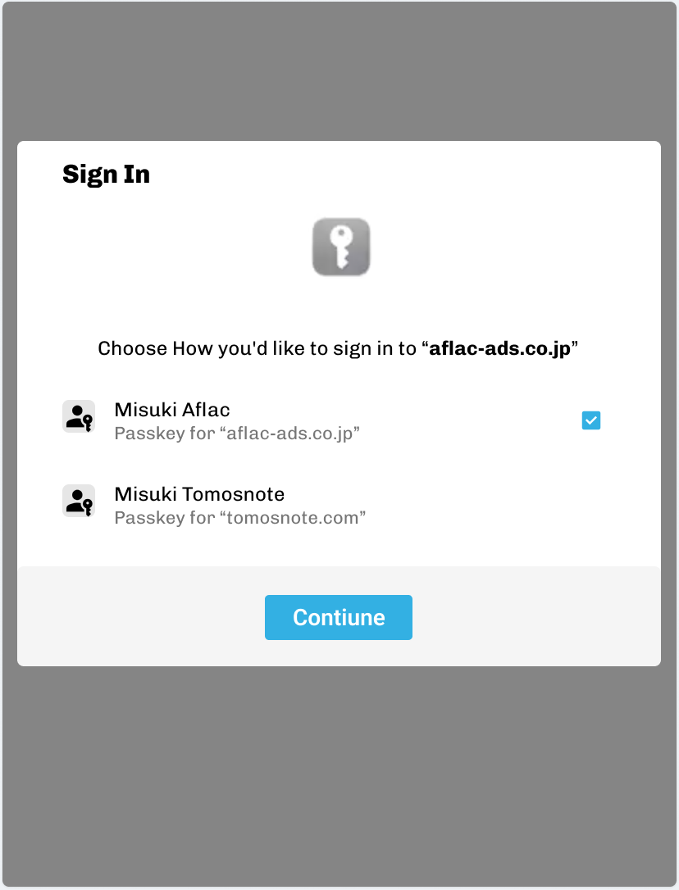
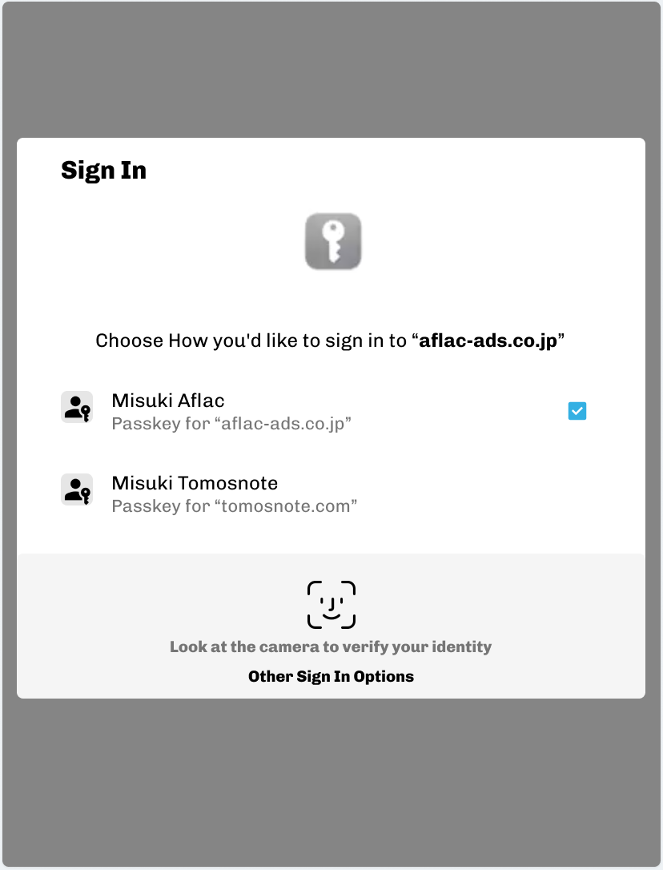
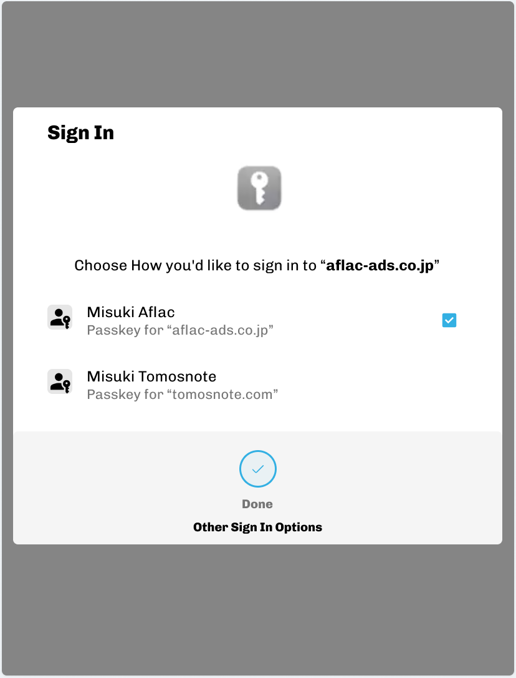
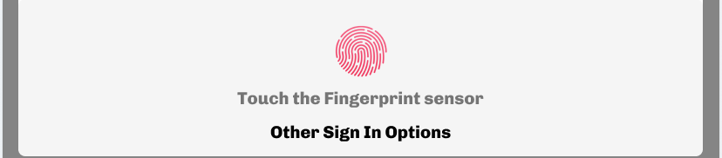
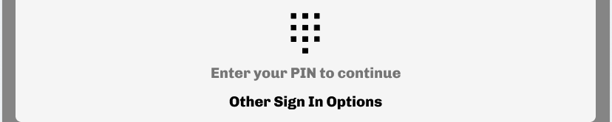
Passkey Login
Increase conversion
Reduce the costs for sending SMS

Slide 7
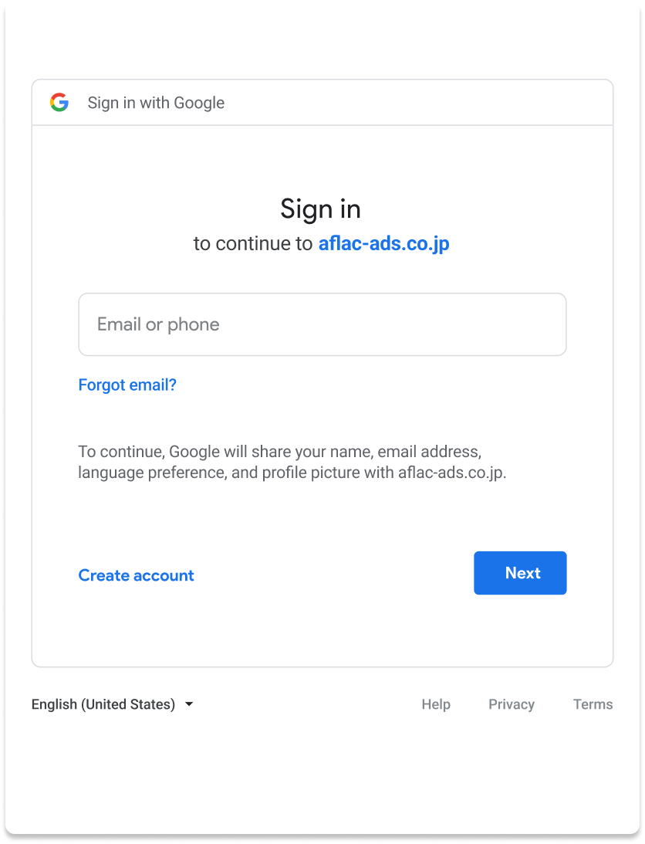
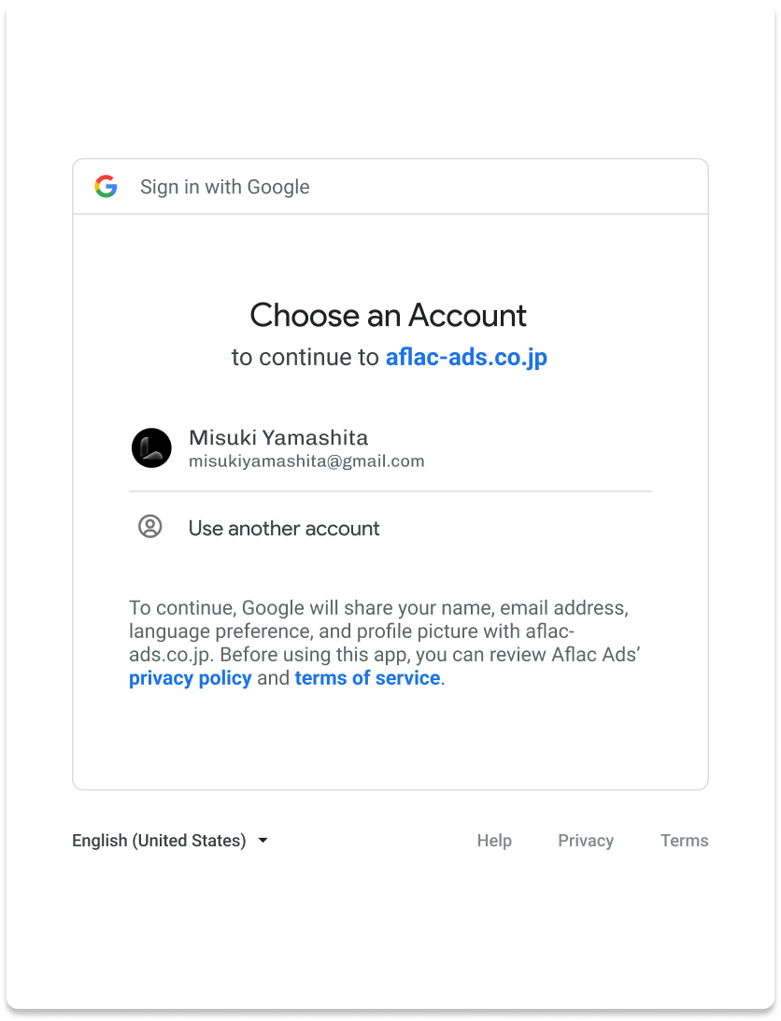
Social Login

Slide 8
Passkey – Easier Faster Safer
Account selector
Users can select an account to sign in with.
Typing the username is not required.
Biometric Authentication
Users can authenticate using device's screen lock such as a fingerprint sensor, facial recognition or entering a PIN.
Cloud-synced access & multi-device login – Key Feature
A passkey can be synchronized across devices via cloud and support multi-device login
Once a passkey is created and registered, the user can seamlessly switch to a new device and continue using it.

Slide 9

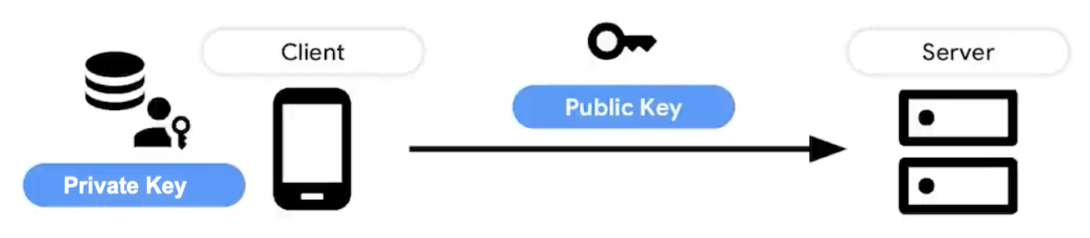





Passkey – Easier Faster Safer
Cryptography
A passkey is based on a key pair — a public key and a private key
The public key is stored on the server
The private key is stored securely on a customer’s device
RPID，Phishing resistant
Passkeys protect users from phishing attacks.
Passkeys work only on their registered websites and apps (Relying Party ID)
Cross-Platform [📱🖥️💻🤖 ]
Passkeys support Mac OS，iOS，iPadOs，Android，Windows and different browsers

Slide 10
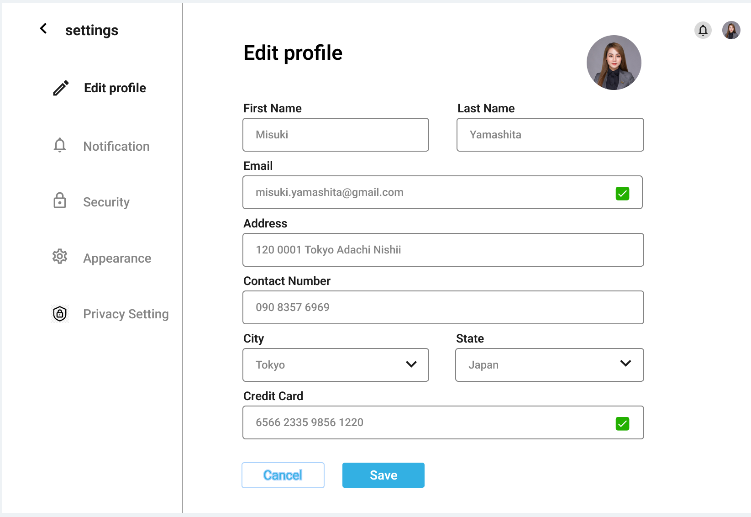
Profile Editing

Slide 11
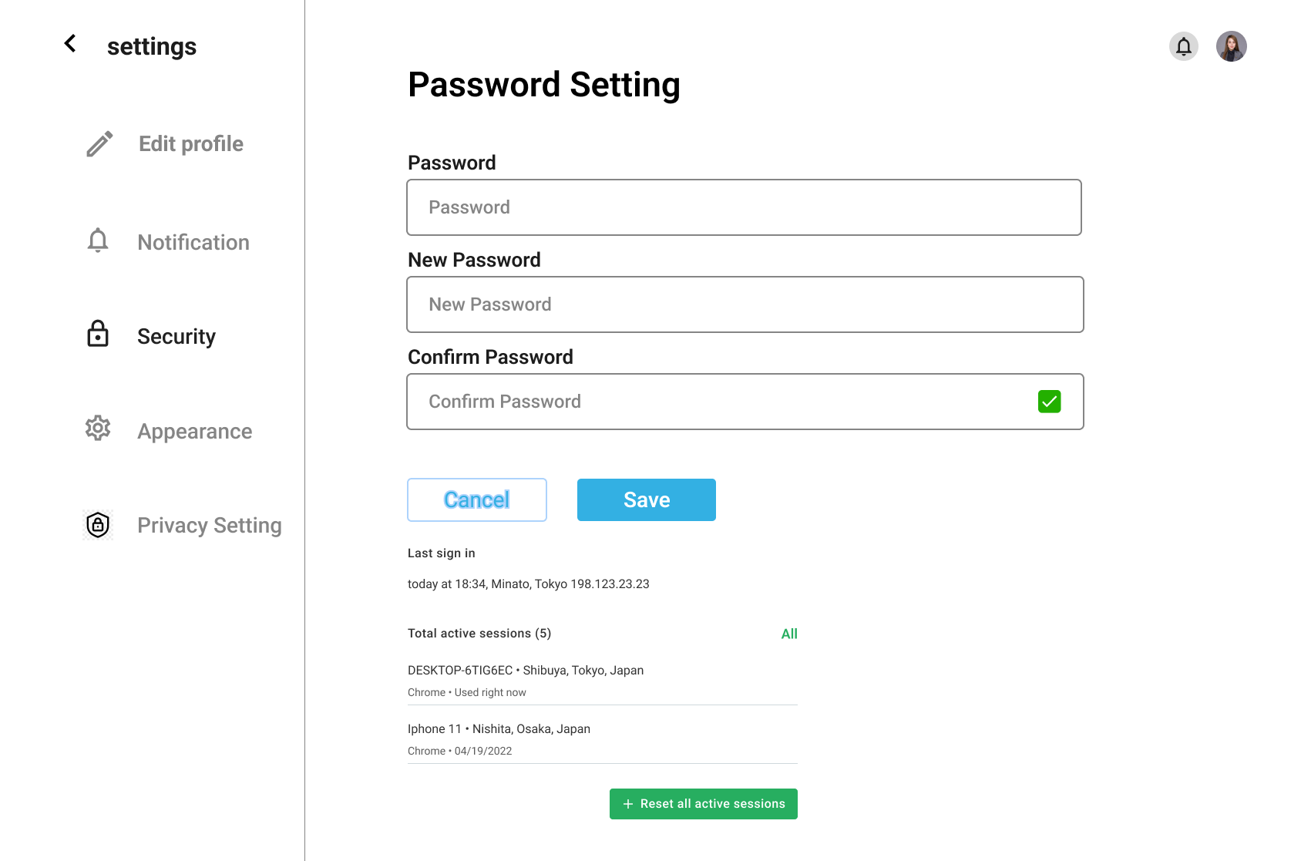
Account Security

Slide 12
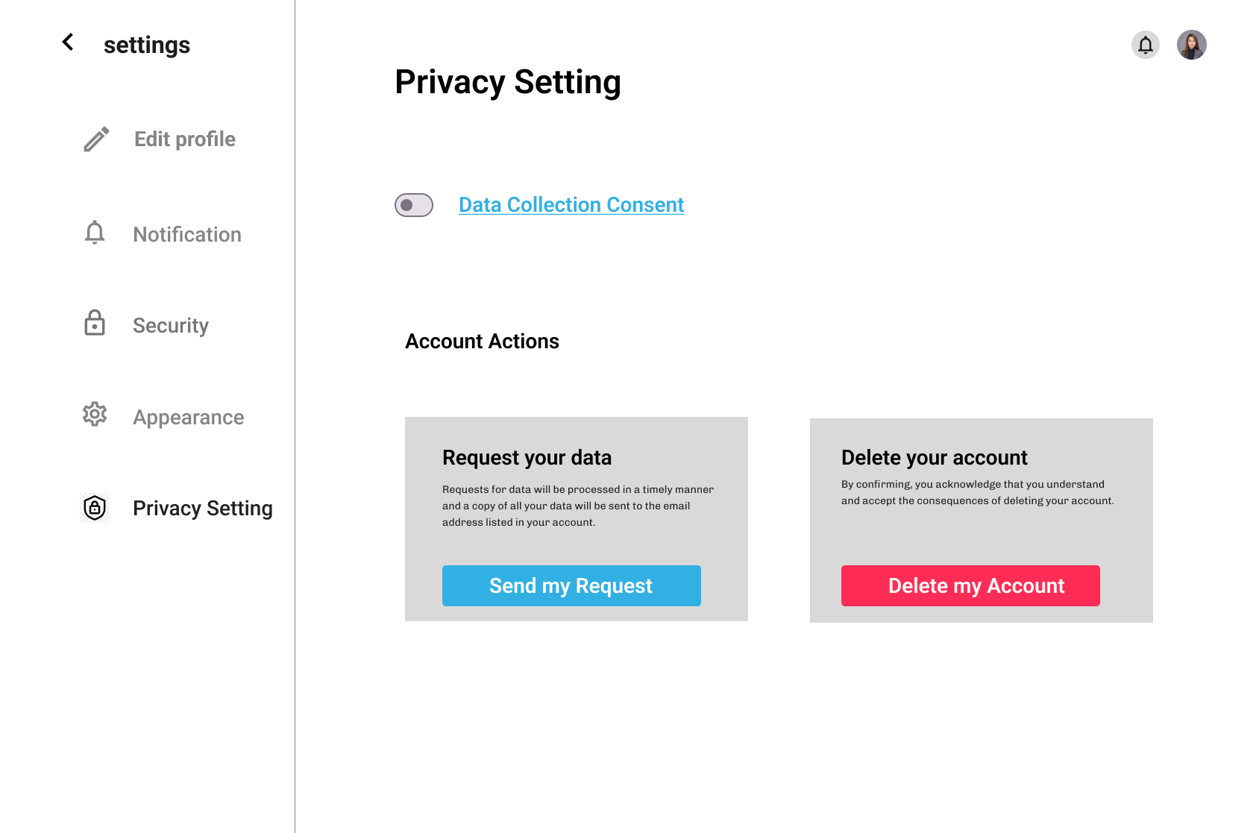
Agreement

Slide 13
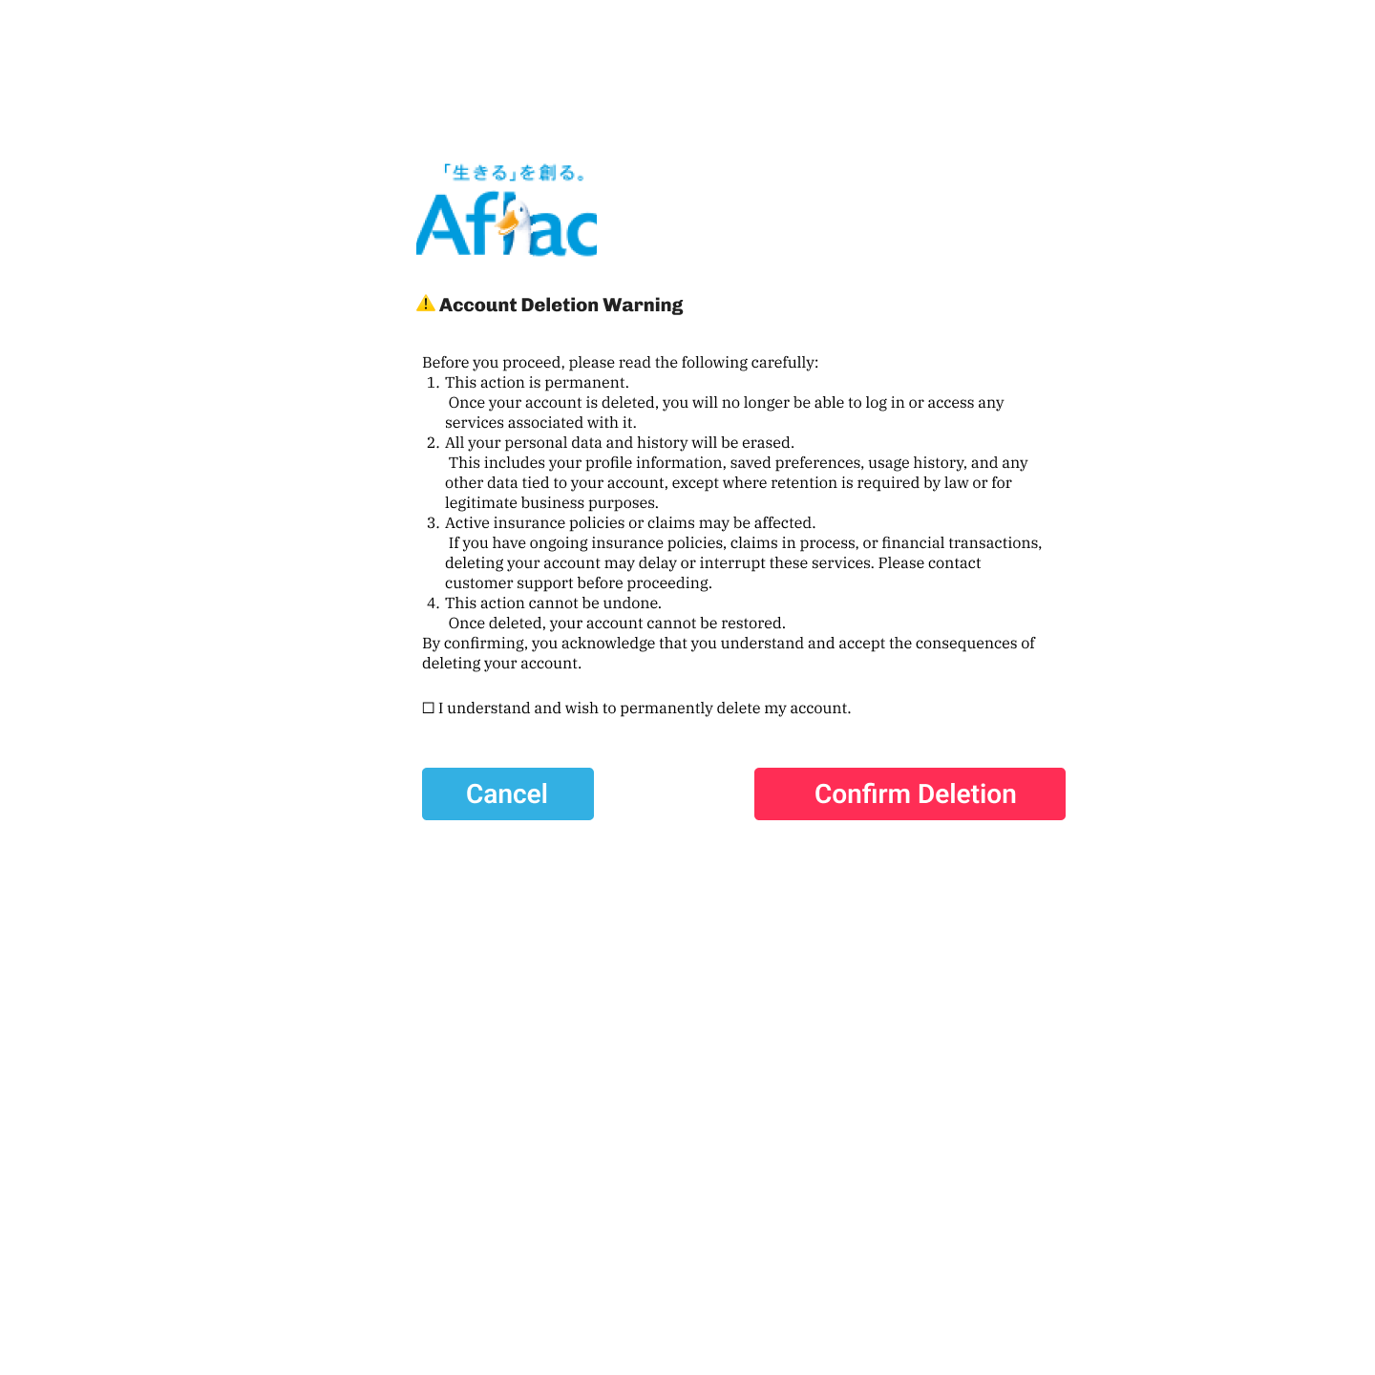
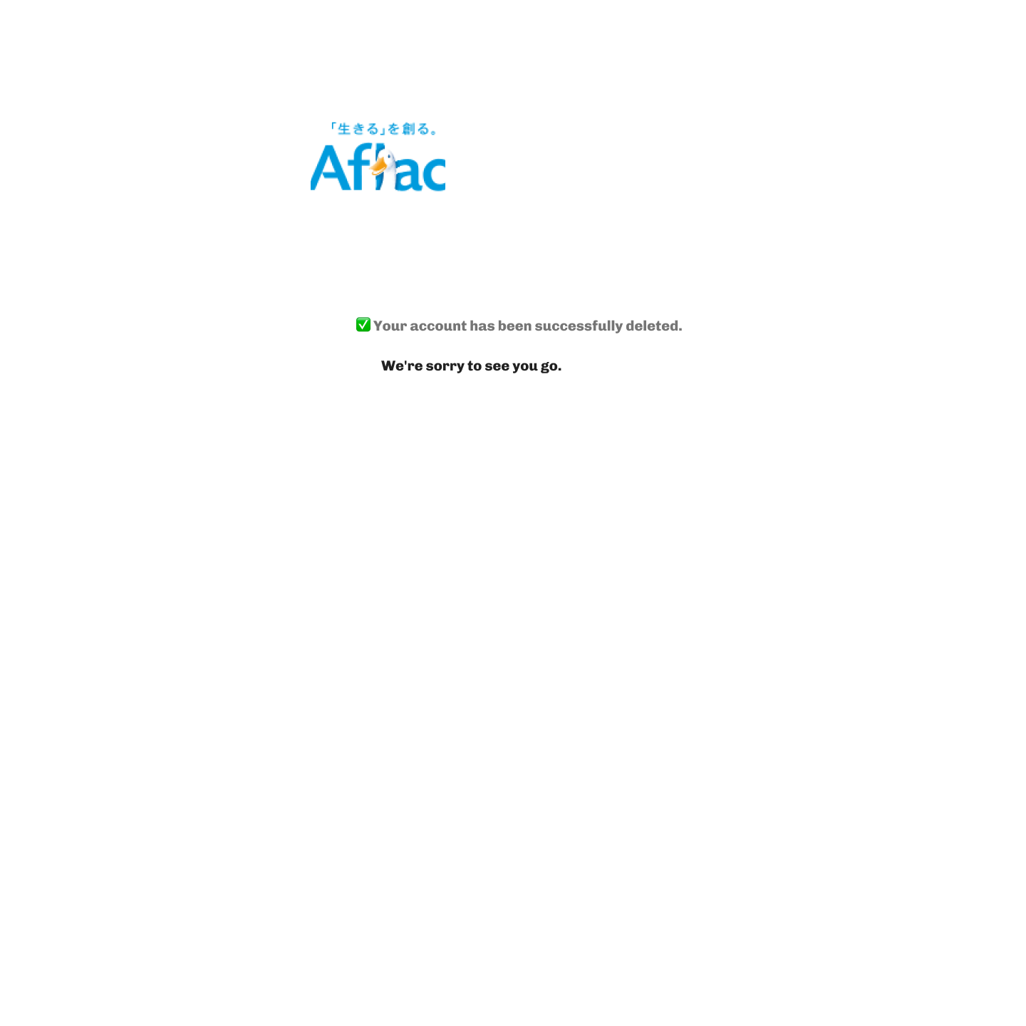
Account Deletion

